Slide 1
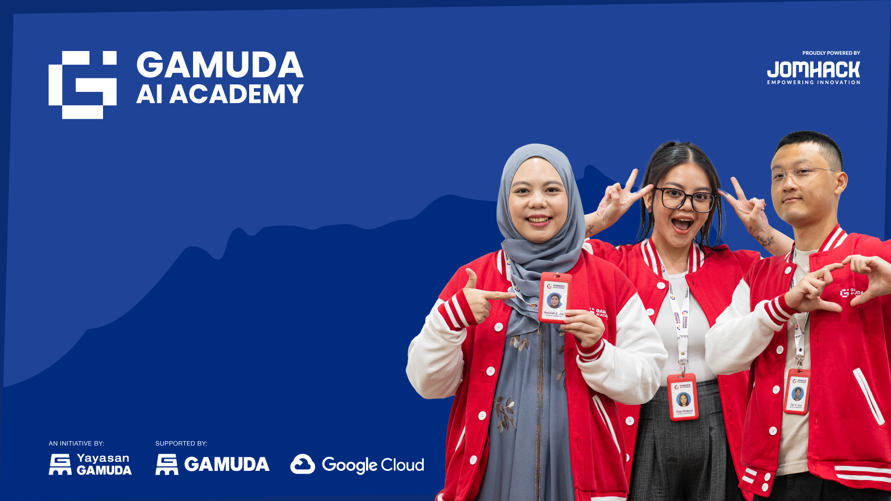
WELCOME
COHORT 5
7th Sept – 3rd Dec 2026
Suite 6-6-7, Level 6, Menara MAA

Slide 2

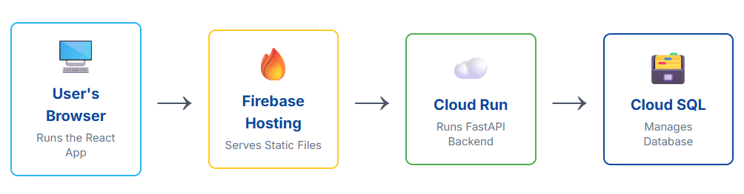
Contents
Introduction to Cloud Run
Backend deployment into serverless live URL

Slide 3
Introduction to Cloud Run
Cloud Run is a fully managed serverless platform offered by Google Cloud Platform (GCP) that allows user to run stateless containers.
Cloud Run is particularly useful for running web applications, APIs, background jobs, and microservices. It's a good choice for developers looking to deploy applications quickly and efficiently in a serverless environment.

Slide 4
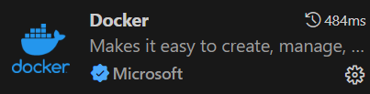
Cloud Run (Docker)
Docker is a popular open-source platform that automates the deployment, scaling, and management of applications using containerization technology
In visual studio extensions, install Docker as follows:
Docker is optional in this lesson: Cloud Build builds the image in the cloud. You only need Docker to build and test containers on your own machine.

Slide 5
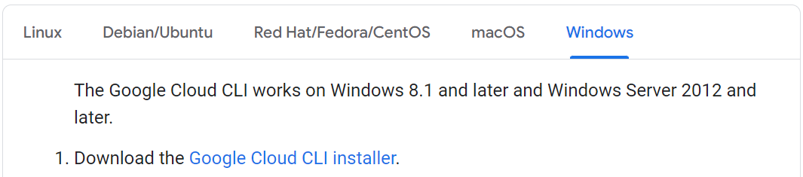
Cloud Run (Google Cloud SDK)
Setup Google Cloud SDK: (Skip this step if you already installed the Google Cloud SDK)
https://cloud.google.com/sdk/docs/install
Windows: open Google Cloud SDK Shell. macOS / Linux: use your normal Terminal.

Slide 6
Cloud Run
Part 1: Creating an API endpoint with Cloud Run

Slide 7
Cloud Run (Setup File)
Create a new folder
In the new folder, create four new files with the following name:
Dockerfile
main.py
requirements.txt
.dockerignore
Refer to the 6.1_cloud_run_deployment folder in Google Drive
Copy/download the codes based on the file name
Dockerfile
main.py
requirements.txt
.dockerignore

Slide 8
Cloud Run
Open Google Cloud SDK Shell (Windows) or Terminal (macOS/Linux), navigate to your project folder, then run these commands one at a time:
gcloud auth login
gcloud config set project your_project_id
gcloud services enable run.googleapis.com cloudbuild.googleapis.com artifactregistry.googleapis.com
gcloud auth list
gcloud auth login signs in with your own Google account. No key file is needed (next slide).
services enable turns on Cloud Run, Cloud Build (builds the image) and Artifact Registry (stores the image).
gcloud auth list shows the active account, marked with *.
Notes:
Commands are editable text. If you retype them, turn off smart quotes / auto-correct in PowerPoint or Google Slides, otherwise straight quotes and double dashes can be changed and the command will fail. The plain-text copy is in gcloud_commands.txt.

Slide 9
Cloud Run (Authentication)
Two different identities are involved. Neither one needs a key file.
Deploying: you
gcloud auth login signs in as your Google account
Your account needs permission to build and deploy (Owner on your own project)
Used for: build, deploy, manage services
Running: your app
Cloud Run runs your container as a runtime service account
Google gives it credentials automatically while the app runs
Used for: connecting to Cloud SQL, reading secrets
Never create or download service account keys (JSON files). A key is a long-lived password: if it leaks, anyone can use it. Many organisations block key creation completely.
Notes:
Replaces the old Service Account Key slides (8-14). Key point: deploy with your own login, run with the runtime service account. Local code uses Application Default Credentials (gcloud auth application-default login), as in the Cloud SQL class.

Slide 10
Cloud Run (Artifact Registry)
Artifact Registry stores your container images. Create one repository for this class:
gcloud artifacts repositories create recipe-repo --repository-format=docker --location=us-central1 --description="Recipe API images"
recipe-repo is the repository name. docker means it stores container images.
--location=us-central1 is the region. Use the same region for Cloud Build and Cloud Run.
Create it once per project. If it already exists you will see an ALREADY_EXISTS error, which is fine.

Slide 11
Cloud Run
Run the following command:
gcloud builds submit --tag us-central1-docker.pkg.dev/your_project_id/recipe-repo/recipe-api
Explanation:
Format: gcloud builds submit --tag [IMAGE_URL]. --tag sets the name and tag of the resulting image.
The full image URL has four parts:
us-central1-docker.pkg.dev is the Artifact Registry hostname for the region
your_project_id is your Google Cloud project ID
recipe-repo is the repository you just created
recipe-api is the name of your image
The command uploads your folder to Cloud Build, builds a Docker image from your Dockerfile and pushes it to Artifact Registry.

Slide 12
Cloud Run
Run the following command:
gcloud run deploy recipe-api --image us-central1-docker.pkg.dev/your_project_id/recipe-repo/recipe-api --region us-central1 --allow-unauthenticated
Explanation:
Format: gcloud run deploy [SERVICE_NAME] --image [IMAGE_URL] --region [REGION] [FLAGS]. It deploys a new Cloud Run service or updates an existing one.
recipe-api is the name of your Cloud Run service
--image is the container image to deploy (the URL from the build step)
--region us-central1 is where your service will run
--allow-unauthenticated allows public access without logging in (fine for this class demo, not for private APIs)

Slide 13
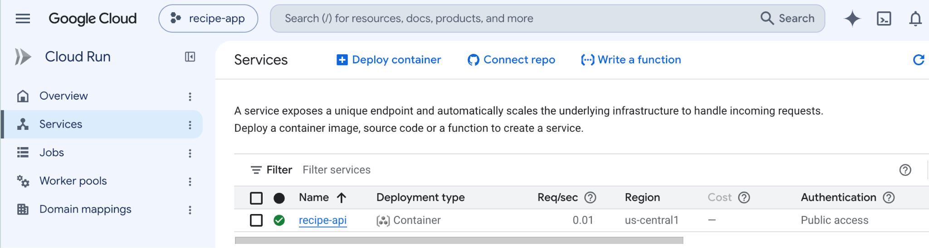
Cloud Run
After successfully deploying the container to the Cloud Run service, the service URL will be generated by Cloud Run.
You can also check the service URL at Google Cloud Console as follows:
Notes:
Cloud Run > Services list showing the recipe-api service.

Slide 14
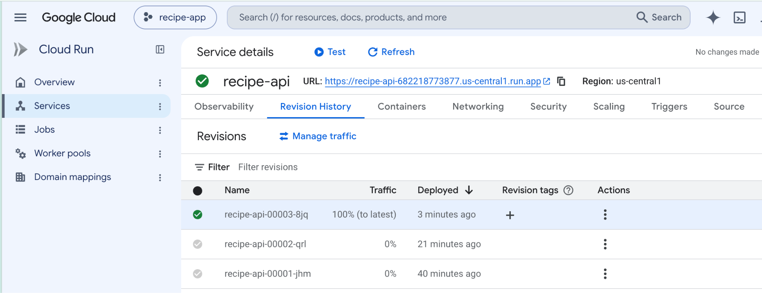
Cloud Run
Refer to the URL as follows :

Slide 15
Cloud Run
Click the URL and set the path to /recipes/
For example:
https://recipe-api-[PROJECT_NUMBER].us-central1.run.app/recipes/
The list of recipes in JSON format will appear as the output.
[
{
"id": 1,
"title": "Pasta Carbonara",
"ingredients": [
"eggs",
"cheese",
"bacon",
"spaghetti",
"black pepper"
],
"instructions": "Boil the spaghetti, fry the bacon, then toss everything with the beaten eggs and cheese off the heat.",
"cooking_time": 20,
"image": "/images/pasta-carbonara.jpg"
},
...
]

Slide 16
Cloud Run
Part 2: Integrate Cloud Run services with Cloud SQL instances

Slide 17
Cloud Run (Setup File)
Create a new folder
In the new folder, create seven new files with the following name:
database.py
main.py
models.py
schemas.py
requirements.txt
Dockerfile
.dockerignore
Refer to the Cloud SQL project folder (5.5 Intro to Cloud SQL class). Copy/download the codes based on the file name and add Dockerfile and .dockerignore.
database.py
main.py
models.py
schemas.py
requirements.txt
Dockerfile
.dockerignore
.env
# .env = local testing only

Slide 18
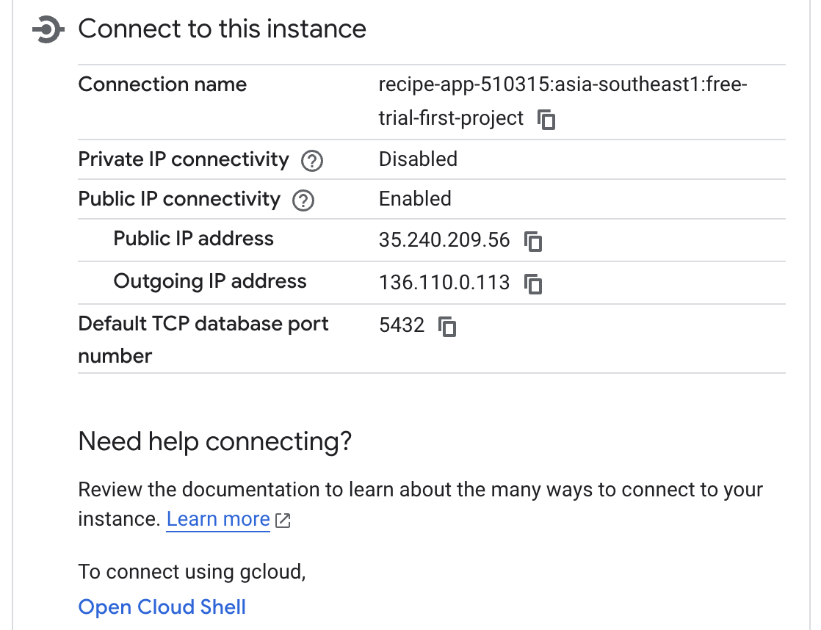
Cloud Run (Cloud SQL)
Use the PostgreSQL instance from 5.5 Intro to Cloud SQL class. If you deleted it, create a new one (refer to 5.5 Intro to Cloud SQL material slides).
Make sure the database recipe_db exists (Databases > Create database).
Get the connection name from the instance Overview:
project-id:region:instance-name
Notes:
RETAKE SCREENSHOT: Cloud SQL instance Overview with Connection name highlighted (replaces old bookstore-db screenshot).

Slide 19
Cloud Run (.env Settings)
database.py is the same. It reads DB_USER, DB_PASS, DB_NAME and INSTANCE_CONNECTION_NAME from the environment.
Locally the values come from your .env file. On Cloud Run they come from --set-env-vars and Secret Manager, so .env is not copied into the image.
.env (local only: never upload or commit it)
DB_USER=your_db_user
DB_PASS=your_db_password
DB_NAME=recipe_db
INSTANCE_CONNECTION_NAME=your_project_id:your_region:your_instance_name

Slide 20
Cloud Run (Dockerfile)
Add these two files to your folder:
Dockerfile
.dockerignore
FROM python:3.12-slim
COPY --from=ghcr.io/astral-sh/uv:latest /uv /uvx /bin/
WORKDIR /app
# Copy requirements first (Docker caches this step)
COPY requirements.txt .
RUN uv pip install --system --no-cache -r requirements.txt
COPY . .
EXPOSE 8080
CMD ["fastapi", "run", "main.py", "--host", "0.0.0.0", "--port", "8080"]
.env
__pycache__/
*.pyc
*.pyo
*.pyd
.git/
.gitignore
venv/
.venv/
env/
.dockerignore keeps .env (your passwords) and your virtual environment out of the image.
uv is copied in so the image installs packages like your laptop does. --system because a container has no virtual environment.
fastapi run is the production version of fastapi dev: no reload, listens on 0.0.0.0:8080, where Cloud Run sends requests.

Slide 21
Cloud Run (requirements.txt)
cloud-sql-python-connector and pg8000 connect to Cloud SQL securely (IAM + SSL), without key files.
pydantic-settings is needed by database.py to read the settings. If it is missing, the container fails to start.
fastapi[standard] includes uvicorn and the fastapi command used in the Dockerfile.
certifi package is for Mac OS.
requirements.txt
fastapi[standard]
uvicorn[standard]
sqlalchemy[asyncio]
psycopg[binary]
pydantic-settings
cloud-sql-python-connector
pg8000
certifi

Slide 22
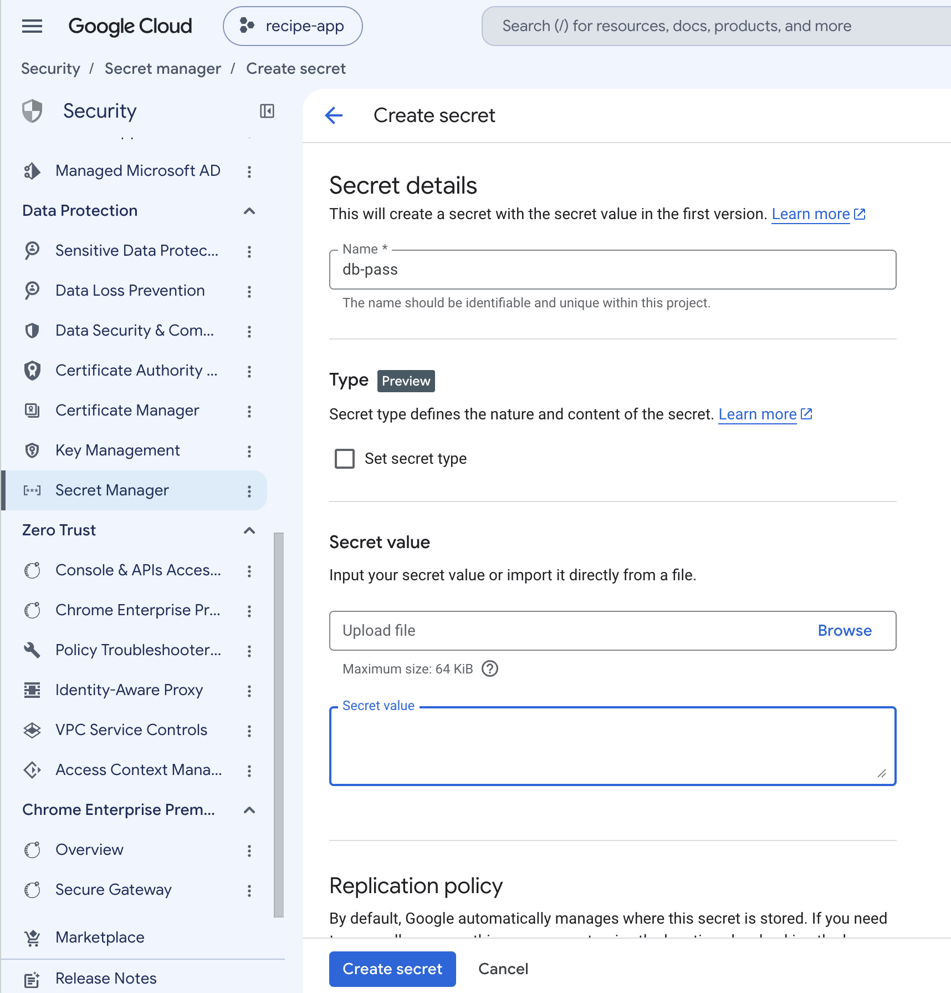
Cloud Run (Secret Manager)
Do not type the database password into a command: it stays in your shell history. Store it in Secret Manager instead.
Enable the API (once):
gcloud services enable secretmanager.googleapis.com
In the console: Security > Secret Manager > Create secret
Name: db-pass
Secret value: your database password
Click Create secret

Slide 23
Cloud Run (Service Account)
Cloud Run runs your app as a service account (by default the Compute Engine default service account). Give it only what the app needs:
1. Find your project number
gcloud projects describe your_project_id --format="value(projectNumber)"
2. Allow the app to connect to Cloud SQL
gcloud projects add-iam-policy-binding your_project_id --member="serviceAccount:PROJECT_NUMBER-compute@developer.gserviceaccount.com" --role="roles/cloudsql.client"
3. Allow the app to read the db-pass secret
gcloud secrets add-iam-policy-binding db-pass --member="serviceAccount:PROJECT_NUMBER-compute@developer.gserviceaccount.com" --role="roles/secretmanager.secretAccessor"
PROJECT_NUMBER is the number printed by command 1 (not the project ID).
No key files: the app receives its credentials automatically while it runs.
In a team project with only Editor access? An Owner must run these once (see appendix).
Notes:
In newer projects/orgs the default Compute Engine service account may not get Editor automatically. If build or deploy fails with permission errors, test in a fresh project first and grant the missing roles (Artifact Registry Writer, Logs Writer, Storage access) to that account.

Slide 24
Cloud Run
In the Google Cloud SDK Shell / Terminal, set the path to this new folder, then run:
1. Build the image
gcloud builds submit --tag us-central1-docker.pkg.dev/your_project_id/recipe-repo/recipe-api
2. Deploy with the database settings
gcloud run deploy recipe-api --image us-central1-docker.pkg.dev/your_project_id/recipe-repo/recipe-api --region us-central1 --allow-unauthenticated --set-env-vars "DB_USER=your_db_user,DB_NAME=recipe_db,INSTANCE_CONNECTION_NAME=project:region:instance" --set-secrets "DB_PASS=db-pass:latest"
--set-env-vars sets the plain settings. --set-secrets injects the secret db-pass as the variable DB_PASS.
Same service name recipe-api: this deploys as a new revision of the Part 1 service.
Keep each command on one line and keep the quotes (PowerShell on Windows needs them).

Slide 25
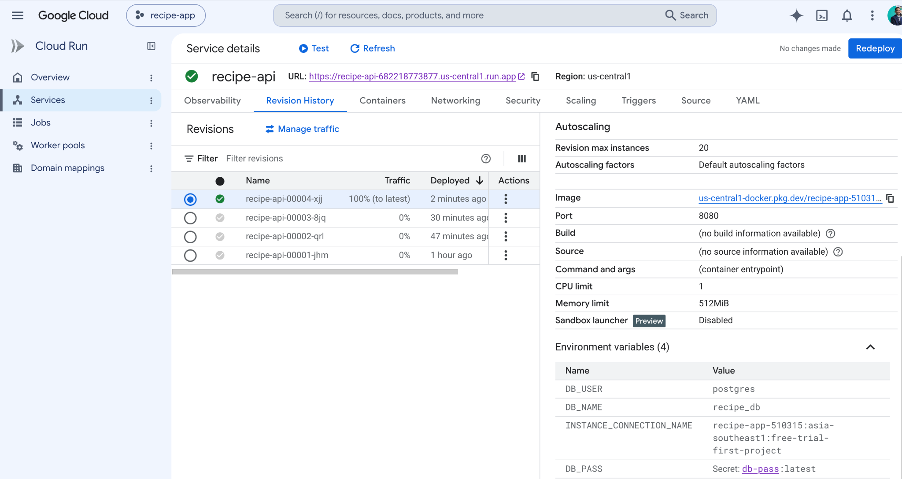
Cloud Run
To check the deployed status, go to Cloud Run > recipe-api > Revisions.
A new revision serving 100% of traffic means the deployment succeeded.

Slide 26
Cloud Run (Redeploy)
Changed your FastAPI code? Rebuild the image, then deploy it again:
1. Rebuild the image with your latest code
gcloud builds submit --tag us-central1-docker.pkg.dev/your_project_id/recipe-repo/recipe-api
2. Deploy it as a new revision
gcloud run deploy recipe-api --image us-central1-docker.pkg.dev/your_project_id/recipe-repo/recipe-api --region us-central1
Cloud Run runs the image, not your folder, so always rebuild after changing code.
Every deploy creates a new revision (Cloud Run > recipe-api > Revisions) and sends 100% of traffic to it. Environment variables and secrets are kept from the previous revision.
Roll back: Revisions > Manage traffic, then send 100% to the previous revision.
Changed an environment variable or secret? Re-run the full deploy command from the Part 2 slide.
Notes:
The short deploy relies on Cloud Run keeping the previous revision's env vars and secrets.

Slide 27
Cloud Run (Troubleshooting)
Container failed to start and listen on the port: open Cloud Run > recipe-api > Logs and read the Python error.
ModuleNotFoundError: a package is missing from requirements.txt (for example pydantic-settings).
Validation error for DB_USER / DB_PASS / ...: a variable or secret is missing from the deploy command.
Permission denied (Cloud SQL): enable the Cloud SQL Admin API and grant Cloud SQL Client to the runtime service account.
Permission denied (secret): grant Secret Manager Secret Accessor on db-pass.
Build or push fails with permission denied: your account lacks Cloud Build or Artifact Registry access (see appendix).

Slide 28
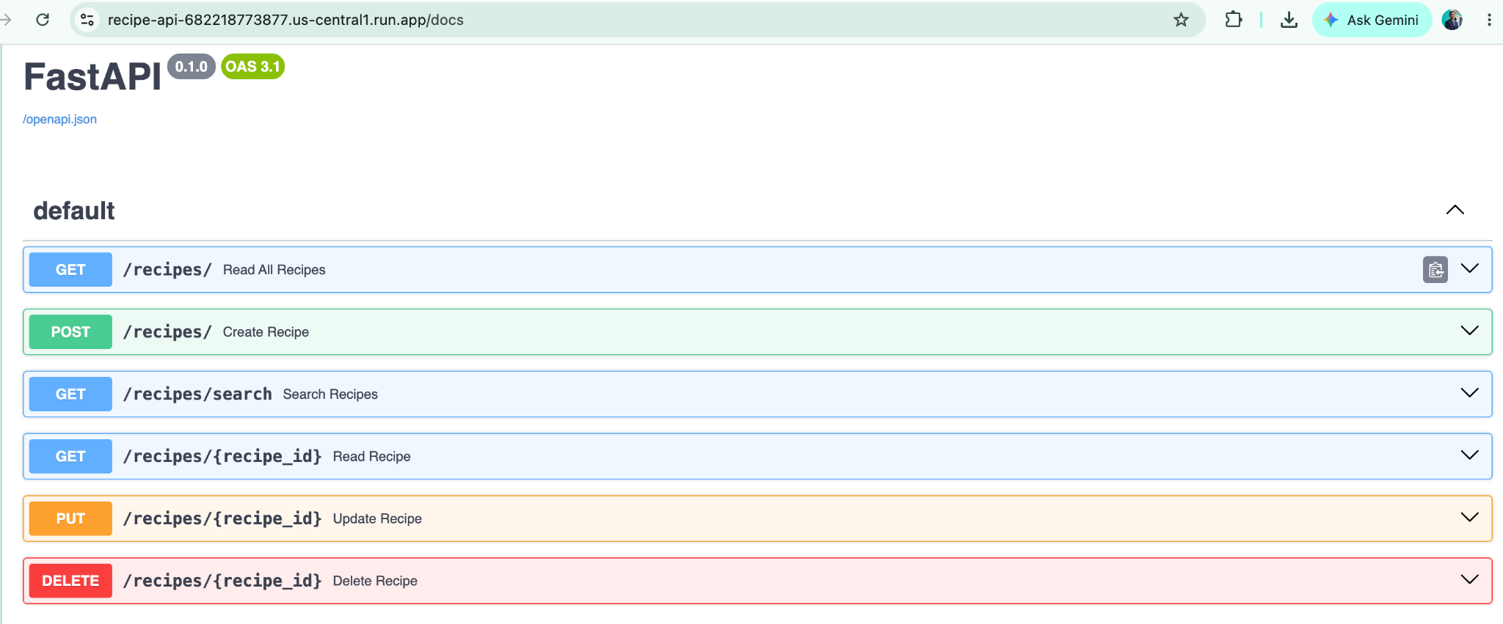
Cloud Run
Click the Cloud Run URL and add /docs to the URL path.
For example:
https://recipe-api-[PROJECT_NUMBER].us-central1.run.app/docs

Slide 29
Cloud Run
Perform the CRUD operations with Swagger UI and observe the data in the Cloud SQL database.
For example, create a new recipe with POST /recipes/ using this request body:
instructions needs at least 10 characters and cooking_time must be greater than 0, otherwise Swagger returns a 422 error.
{
"title": "Nasi Lemak",
"ingredients": "rice, coconut milk, sambal",
"instructions": "Cook rice in coconut milk.",
"cooking_time": 45,
"image": null
}

Slide 30
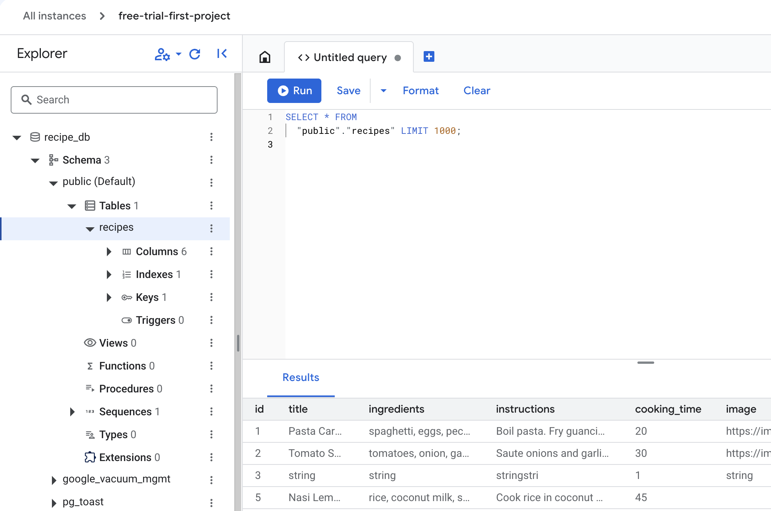
Cloud Run
Check the data in the Cloud SQL database (Cloud SQL Studio).

Slide 31
Cloud Run (Clean Up)
Delete what you no longer need so it does not keep costing money:
Cloud Run service
gcloud run services delete recipe-api --region us-central1
Container images
gcloud artifacts repositories delete recipe-repo --location us-central1
Database password secret
gcloud secrets delete db-pass
Each command asks you to confirm with y.
Finally, delete the Cloud SQL instance (next slide). It costs the most.

Slide 32
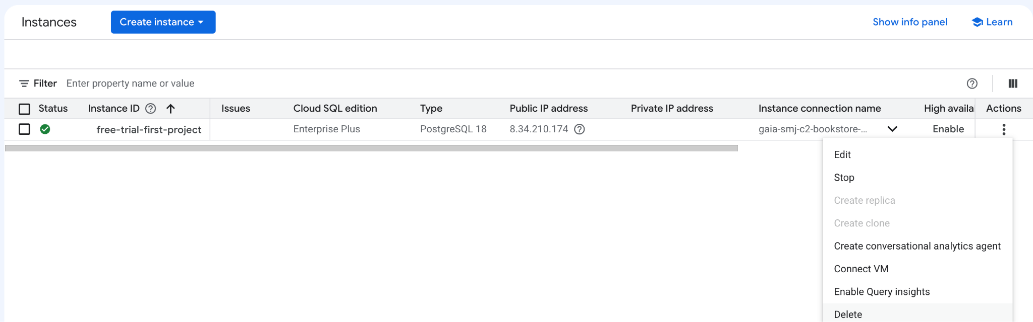
Cloud SQL (Remove Instance)
Navigate to instances and then delete the instance.

Slide 33
Cloud Run (Additional)
Useful when you switch between your own account and a team project:
See which account is active (marked with *)
See the current project
gcloud auth list
gcloud config get-value project
Switch the active account
Change the project
gcloud config set account ACCOUNT
gcloud config set project your_project_id
Sign in with another Google account
Sign out of an account
gcloud auth login
gcloud auth revoke ACCOUNT

Slide 34
Cloud Run (Team Project)
In a shared capstone project you may not be Owner. Ask an Owner for these roles:
Everyone who deploys
Cloud Run Admin
Cloud Build Editor
Artifact Registry Administrator
Storage Admin
Service Usage Admin
Service Account User
Secret Manager Admin
Logs Viewer
Owner / IAM Admin (one time)
Grant Cloud SQL Client and Secret Manager Secret Accessor to the runtime service account (commands on the Service Account slide)
Editor cannot change IAM policies, so an Owner has to do this
Optional: create a dedicated runtime service account for the team and deploy with --service-account
Still no key files

